Slide 1
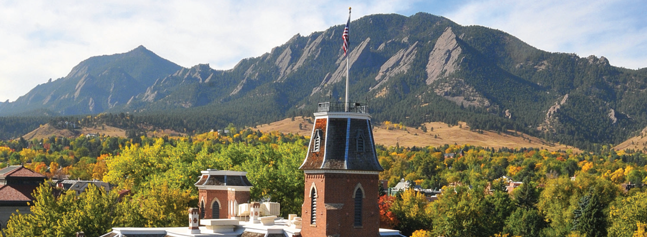
Filesystems and Storage on RMACC Summit

Slide 2
Filesystems and Storage on RMACC Summit
Mea Trahan
Email: Daniel.Trahan@Colorado.edu
RC Homepage: https://www.colorado.edu/rc
RC Email: rc-help@colorado.edu
Slides available for download at:
https://github.com/ResearchComputing/Filesystems_And_Storage_Fall_2020

Slide 3
Outline
Overview of Summit’s storage
Summit architecture and filesystems
Petalibrary
Data transfers and tools

Slide 4
Quick note
Clusters come in all shapes and sizes, so much of the information here may not apply to other systems. HPC is a very diverse landscape so make sure you check with the system administrators of whichever cluster you are using.

Slide 5
Overview of CURC’s directories
3 major user directories
Home – Used for reusable job scripts, setting files, and other important small files.
Projects – Used for application and small datasets.
Scratch – Work directory. Used with jobs for highspeed access to data or output.
Table:
 | Directory | Capacity | Backup | Purge
Home | /home/$USER | 2 GB | 2 hours for 7 days | Never
Projects | /projects/$USER | 250 GB | 6 hours for 7 days | Never
Scratch | /scratch/summit/$USER | 10 TB | (none) | 90 days

Slide 6
What’s makes Summit different?
As you may know Research Computing resources diverge a bit from the average computer.
Complex severs architecture connected to two separate clusters
Various endpoints and services
Several Filesystems for various purposes.
When you log into Summit all of this seems “seamless…”
So what gives?

Slide 7
RC’s network
The user facing side of RC’s network is composed of 3 major structures:
Login Nodes
VMs with very little compute capability
Can access RMACC Summit compile nodes by running ssh scompile with the slurm/summit module loaded.
Can access Blanca by loading slurm/blanca and submitting an interactive job.
Summit
CU Boulder high performance computing resource.
Composed of forward-facing 483 compute nodes and 2 compile nodes.
Blanca
Buy in condo nodes that compose a heterogeneous compute cluster.
Check with your group if you’d like access to this resource.

Slide 8
RC’s network
Heterogeneous Nodes
Blanca
Compile Nodes
Compute Nodes
Login Nodes
RMACC Summit

Slide 9
RC’s filesystems
To reduce the amount of complexity for an end user to manage, RC uses a shared file server to manage user related storage.
“Core Storage”
Contains /home, /projects, and /rc_scratch
Contains all shared software and the module stack.
Every node or login VM is connected to this resource allow user to easily manage their files.
Non-Parallel IO
Slow reads and writes

Slide 10
RC’s Storage
Heterogeneous Nodes
Blanca
/home
/projects
/curc
...
Core Storage
Compile Nodes
Compute Nodes
Login Nodes
RMACC Summit

Slide 11
Problems with I/O and threads
Suppose someone is computing with 120 threads and needs to write their data to a file system…
Single File:
Many threads means that applications may idle waiting for free resources.
Nonlocking I/O may cause corruption of data.
Many Files:
Separate file writes may lead to issues with the filesystem’s metadata service.
So what do we do?
Worker 1
Worker 2
Worker 3
Output Data
Worker 1
Worker 2
Worker 3
Output 1
Output 2
Output 3

Slide 12
RC’s Parallel filesystems
RC provides an additional system local parallel file system available on Summit.
Scratch Space:
Spinning disk platters rated at 12 Gb/s
GPFS File System for parallel I/O w/ 32 Clints and 4 Servers
Distributed metadata to avoid bottlenecking
Consistent chunking allows for parallel I/O
Locally mounted on Summit nodes.
Scratch is usually limited to 10 TB of storage but can be expanded upon with request.
Purges every 90 days from file creation
Technically shared among all users
Scratch totals in 1 PB of storage for everyone

Slide 13
Parallel Filesystem
Normal application I/O is usually lacking the ability to leverage a parallel file system for performance
On Summit you will naturally get an I/O performance boost when using scratch.
Need to utilize specialized software libraries
MPIIO
Middle wear, requires modification of code for efficient usage.
HDF5
High level, use a HDF5 dataset
NETCDF
High level use a Netcdf dataset

Slide 14
Local Node SSDs
Summit Nodes also hold onto 100 GB of local node SSD storage.
These SSDs are not shared among nodes so must move files over within job.
No Cooperative Parallel I/O
Located at /scratch/local

Slide 15
Some more filesystems…
High Performance I/O is less available with Blanca
Petalibrary Active
High Speed performance
Allows for parallel reads and writes
Currently utilizes BeeGFS as its parallel filesystem, will be switching to GPFS
More on this in a minute…
RC_Scratch
Not the best storage on RC…
Older scratch space past its service dates
Large but slow
“I’m sometimes wonder if /projects or /home would be faster than rc_scratch…”

Slide 16
Parallel Filesystems
Heterogeneous Nodes
Blanca
/home
/projects
/curc
/rc_scratch
...
/scratch/summit
/scratch/local
Core Storage
Compile Nodes
Compute Nodes
Login Nodes
RMACC Summit

Slide 17
What is Petalibrary?
Research Computing offers a subsidized but paid, long-term storage solution closely coupled with RC resources.
Petalibrary
Large scale subsidized storage solution
Enterprise Grade
RC Staff supported with assistance on transfer strategies
Available in several flavors:
Active – Disk
Archival – Tape
Active Storage with Archive copy

Slide 18
Hardware Specifications
Active Storage
Spinning disk platters for frequent reads and writes
GPFS filesystem
Parallel file I/O capable
RAID-6 file protection
Allocations located at: /pl/active/
Archive Storage
Tape storage for infrequent reads and writes
iRods backed with StrongBox
Redundant copies of Data on separate tapes
Allocations located at: /pl/archive/

Slide 19
Petalibrary
/pl/active
/pl/archive
Heterogeneous Nodes
Active
Archive
Blanca
Petalibrary
/home
/projects
/curc
/rc_scratch
...
/scratch/summit
/scratch/local
Core Storage
Compile Nodes
Compute Nodes
Login Nodes
RMACC Summit

Slide 20
Checking your storage limits:
curc-quota – Research computing tool to monitor disk usage.
Provides detailed summary of your core storage
Provides detailed summary of scratch space on compile and compute nodes
Also lists current capacity of all Petalibrary allocations you have access to
[userXXXX@login12 ~]$ curc-quota

Slide 21

Data Transfers
Data transfers are usually handled by one of 2 methods:
Globus
By far the most stable and recommended way for data transfers
Fast transfers
Transfers continue if a user disconnects
Web GUI option or Globus Connect Personal
SCP/SFTP
Secure Copy and Secure File Transfer Protocol
Straightforward method of transferring data
Generally recommend only to move small files less than a Gigabyte.

Slide 22
More on Data transfers
Less common methods of transferring data…
sshfs
Mounting the RC filesystem to your drive remotely!
Single sign in for multiple data transfers
Great when needing to repeatedly access files on RC Resources
rsync/rclone
Another utility to transfer files
Particularly useful in repeated file transfers and synchronization of file sets
Snapshot like backups
https://github.com/ResearchComputing/Documentation/blob/dev/docs/compute/rclone.md

Slide 23
Some additional notes…
Do not run your job against /home or /projects
Slows down your jobs.
Slows down everyone else’s jobs.
We monitor for this and will kindly ask you to stop.
Use Scratch instead for your data!
Always recover your data from scratch after your job completes!
No backup and we can’t get your data back!
Always have a safe backed up location for your data!

Slide 24
Questions?

Slide 25
Thank you!
Please fill out the survey: http://tinyurl.com/curc-survey18
Contact information: rc-help@Colorado.edu
Slides: https://github.com/ResearchComputing/Filesystems_And_Storage_Fall_2020

